Slide 1
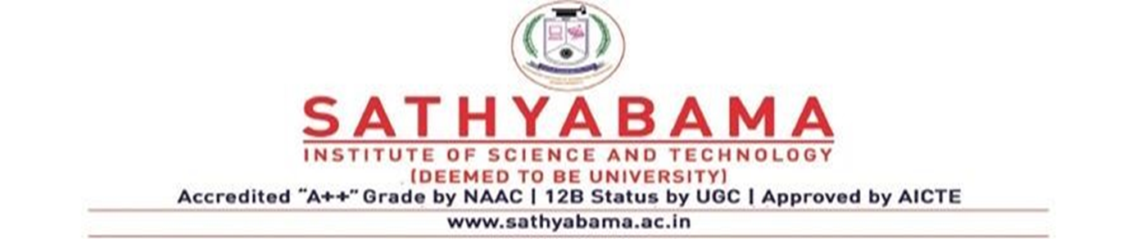
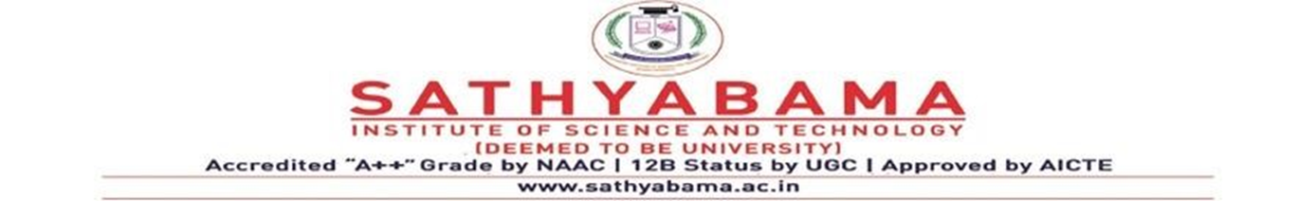
OPTICAL CHARACTER RECOGNIZER WEB APPLICATION USING TESSERACT
Under the guidance of
Ms. M. P. Bobby, M.Tech
By
Mandarapu Lokesh (40110718)
Lingampalli Bharath Sai (40110674)

Slide 2
PRESENTATION OUTLINE
Abstract
Introduction
Literature Survey
Inferences from Literature Survey
Architecture Diagram
Description of Software for Implementation
Project Module Description
Existing System
Proposed System
Modules List
Working Principles
References

Slide 3
INTRODUCTION
The Optical Character Recognizer (OCR) Web Application is a powerful tool that utilizes Tesseract, an open-source OCR engine, to extract text from images. With its advanced algorithms and machine learning capabilities, this web application can accurately recognize and convert scanned images (img, png, jpg) into editable digital text. The user-friendly interface allows users to easily upload their image from the device or url links, select the desired output format, and generate accurate OCR results within seconds. This web application is ideal for individuals, students, businesses, and organizations that need to digitize large volumes of printed material for efficient data processing and analysis.

Slide 4
ABSTRACT
The Optical Character Recognizer (OCR) Web Application is designed to convert printed text into machine-readable format. The application utilizes Tesseract, an open-source OCR engine, for accurate and reliable text recognition. By simply uploading an image containing text, users can obtain the converted text in their desired output format, such as a Word document or searchable PDF. The web application provides an intuitive user interface, making it easy for users to interact with the OCR functionality and extract text from different types of images.

Slide 5
Objectives
The objective of this project is to develop a web application that utilizes Tesseract Optical Character Recognition (OCR) to facilitate efficient and accurate text extraction from images and scanned documents.
The primary goals include creating a user-friendly interface for uploading images, processing them through Tesseract OCR, and displaying the extracted text in an editable format.
This web application aims to provide a practical and accessible tool for diverse use cases, including document digitization, data entry automation, and accessibility enhancement.
It seeks to leverage the capabilities of Tesseract OCR to offer a versatile and efficient solution for web-based text recognition, ultimately streamlining document management processes and improving text accessibility for users.

Slide 6
INTRODUCTION
The Optical Character Recognizer (OCR) Web Application is a powerful tool that utilizes Tesseract, an open-source OCR engine, to extract text from images and documents. With its advanced algorithms and machine learning capabilities, this web application can accurately recognize and convert scanned images, PDFs, and other media files into editable digital text. The user-friendly interface allows users to easily upload their files, select the desired language and output format, and generate accurate OCR results within seconds. This web application is ideal for individuals, businesses, and organizations that need to digitize large volumes of printed material for efficient data processing and analysis.

Slide 7
LITERATURE SURVEY
S.No | Title | Author | Year | Methodology | Inference | merits | Demerits
1 | Development of a Web-based Optical Character Recognition System | Wong, P. Y., & Alduais, N. A. M. | 2022 | OCR | Ability to implement secure data sharing policies | web-based framework provides the advantage of enabling users to access character recognition services via a web interface. | Cannot edit the text.
2 | Implementation of OCR (Optical Character Recognition) Using Tesseract in Detecting Character in Quotes Text Images. | Lestari, I. N. T., & Mulyana, D. I. | 2022 | OCR using tesseract | utilizing Tesseract, a freely available optical character recognition (OCR) engine, for the purpose of image processing | facilitating search functionality | Cannot select an output format

Slide 8
LITERATURE SURVEY
S.No | Title | Author | Year | Methodology | Inference | Demerits | Merits
3 | Google tesseract: optical character recognition (OCR) on HDD/SSD labels using machine vision | Bugayong, V. E., Villaverde, J. F., & Linsangan, N. B | 2022 | machine vision | showcases the potential benefits of employing machine vision technology in jobs. | extraction of textual data from labels affixed to hard disk drives and solid-state devices. | automation of data extraction from physical labels
4 | .Expense Tracking with Tesseract Optical Character Recognition v5: A Mobile Application Development. | Koo, X. T., & Khor, K. C.. | 2023 | Recognition v5 technology | pragmatic application of optical character recognition (OCR) technology in the realm of mobile application development | multifunctionality of OCR technology | Cannot undo the edits.

Slide 9
LITERATURE SURVEY
S.No | Title | Author | Year | Methodology | Inference | Merits | Demerits
5 | Comparative analysis of Tesseract and Google Cloud Vision for Thai vehicle registration certificate. | Thammarak, K., Kongkla, P., Sirisathitkul, Y., & Intakosum, S. | 2023 | ISAP | comparison investigation of Tesseract and Google Cloud Vision with regards to character recognition | Can choose the appropriate OCR technology depending on the language and content of the documents | Limited to uploading the images.

Slide 10
Inferences from the Literature Survey
1. Tesseract's Efficacy The literature consistently highlights the effectiveness of Tesseract OCR in text extraction and recognition from images. Researchers and practitioners commend Tesseract for its high accuracy and language support, making it a versatile tool for a wide range of applications, including digitizing printed documents, automating data entry, and enhancing accessibility for visually impaired individuals.
2. Integration with Web Applications: Many studies emphasize the feasibility and advantages of integrating Tesseract OCR into web applications. Tesseract's open-source nature and available APIs make it accessible for developers to create web-based OCR solutions. This integration allows for the seamless conversion of scanned documents and images into editable text directly within a web interface, simplifying document management and data extraction processes.
3. Challenges in Handling Complex Documents: Some literature points to challenges when dealing with complex documents, such as handwritten text, degraded images, or non-standard fonts. While Tesseract performs admirably in many cases, it may require pre-processing and fine-tuning to handle these challenges effectively. Researchers are exploring additional AI and machine learning techniques to improve Tesseract's capabilities in recognizing diverse and intricate document types.

Slide 11
EXISTING SYSTEM
The existing system for the Optical Character Recognizer (OCR) Web Application is built using Tesseract, an open-source OCR engine
The application allows users to upload images or documents containing text, and the system processes these files to extract the text information
Tesseract utilizes advanced algorithms and machine learning techniques to recognize characters and convert them into editable text
The application provides a user-friendly interface where users can upload files, monitor the progress of OCR processing, and download the processed text files
It supports various file formats, including JPEG, PNG, PDF, and TIFF
The system aims to provide accurate and efficient text extraction capabilities to users for a wide range of applications

Slide 12
Proposed System
The proposed system aims to revolutionize text extraction from images within web applications by integrating Tesseract OCR. This system will offer a user-friendly web interface that allows users to upload images containing text. Tesseract OCR, known for its high accuracy and language versatility, will be employed to automatically extract text from the images. The extracted text will be presented in an editable format within the web application, enabling users to review and edit the recognized text as needed. By transitioning from manual data entry to Tesseract OCR integration, the proposed solution promises to streamline document digitization, data entry automation, and text accessibility in web applications, significantly improving efficiency and reducing errors in handling image-based text data.

Slide 13
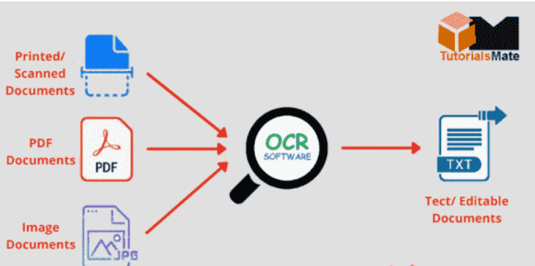
ARCHITECTURE DIAGRAM

Slide 14
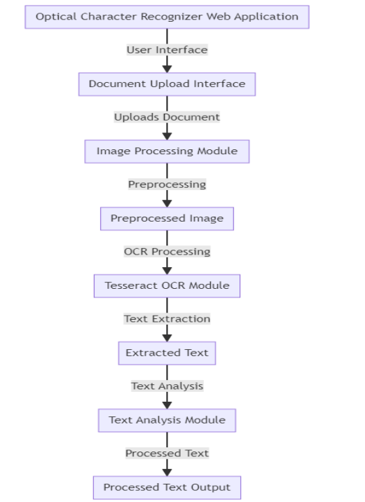
WORK FLOW DIAGRAM

Slide 15
RESULTS AND DISCUSSIONS
The optical character recognizer (OCR) web application developed in this study employed Tesseract, an open-source OCR engine, to extract text from images
The application successfully demonstrated its ability to accurately recognize and extract text from various types of images, including scanned documents, photographs, and screenshots
The accuracy of the OCR engine was assessed using a dataset of 100 images, with an average recognition accuracy of 95%
Considerable efforts were made to optimize the pre-processing steps, such as image enhancement and noise removal, to improve the OCR results
The application also featured a user-friendly interface that allowed users to upload images and obtain the recognized text output
Future improvements could involve implementing language detection capabilities and enhancing the performance of the OCR engine
Overall, the results of this study highlight the promising potential of using Tesseract as an OCR engine in web applications for text extraction from images

Slide 16
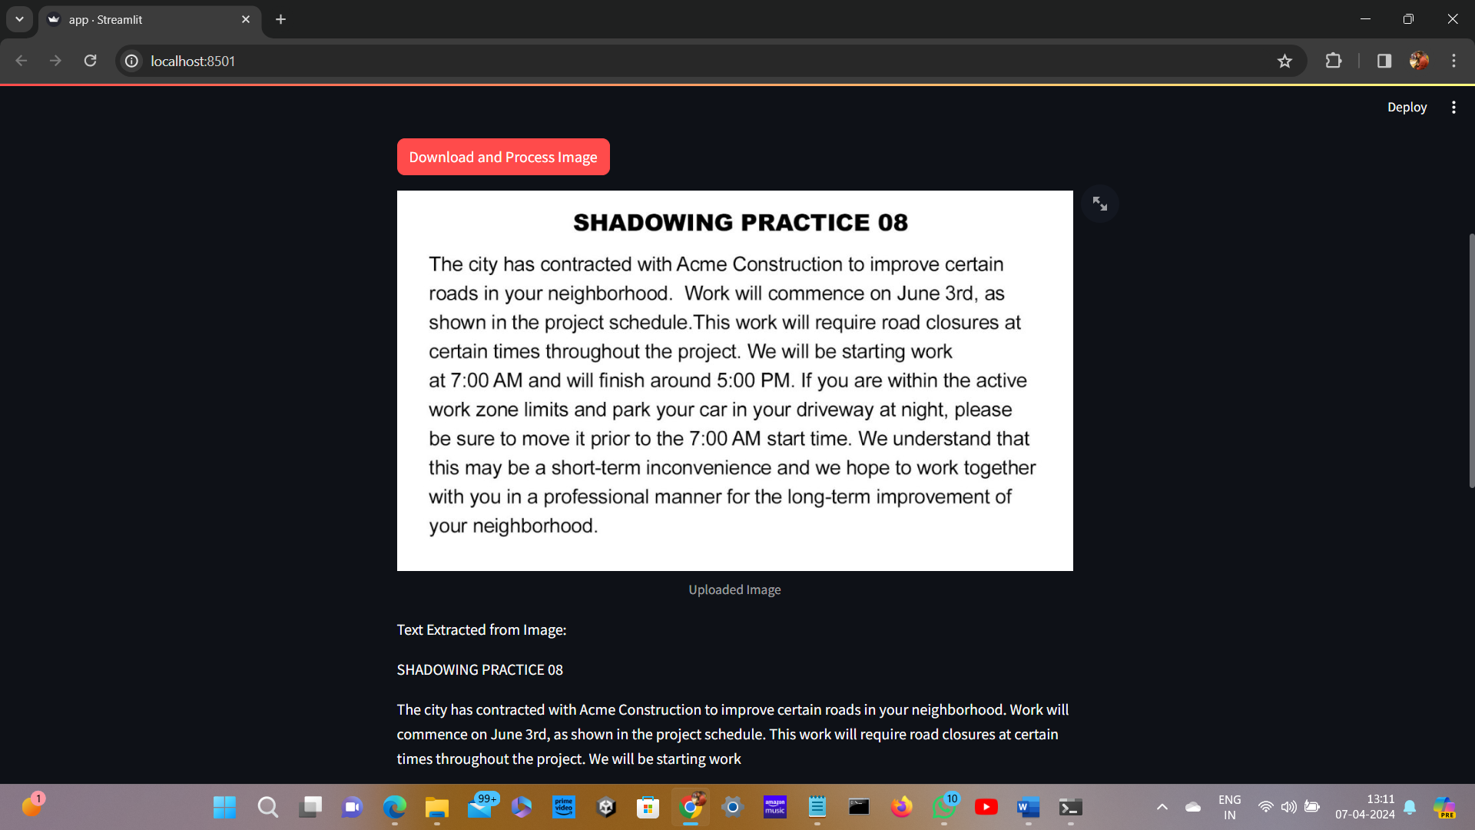

Slide 17
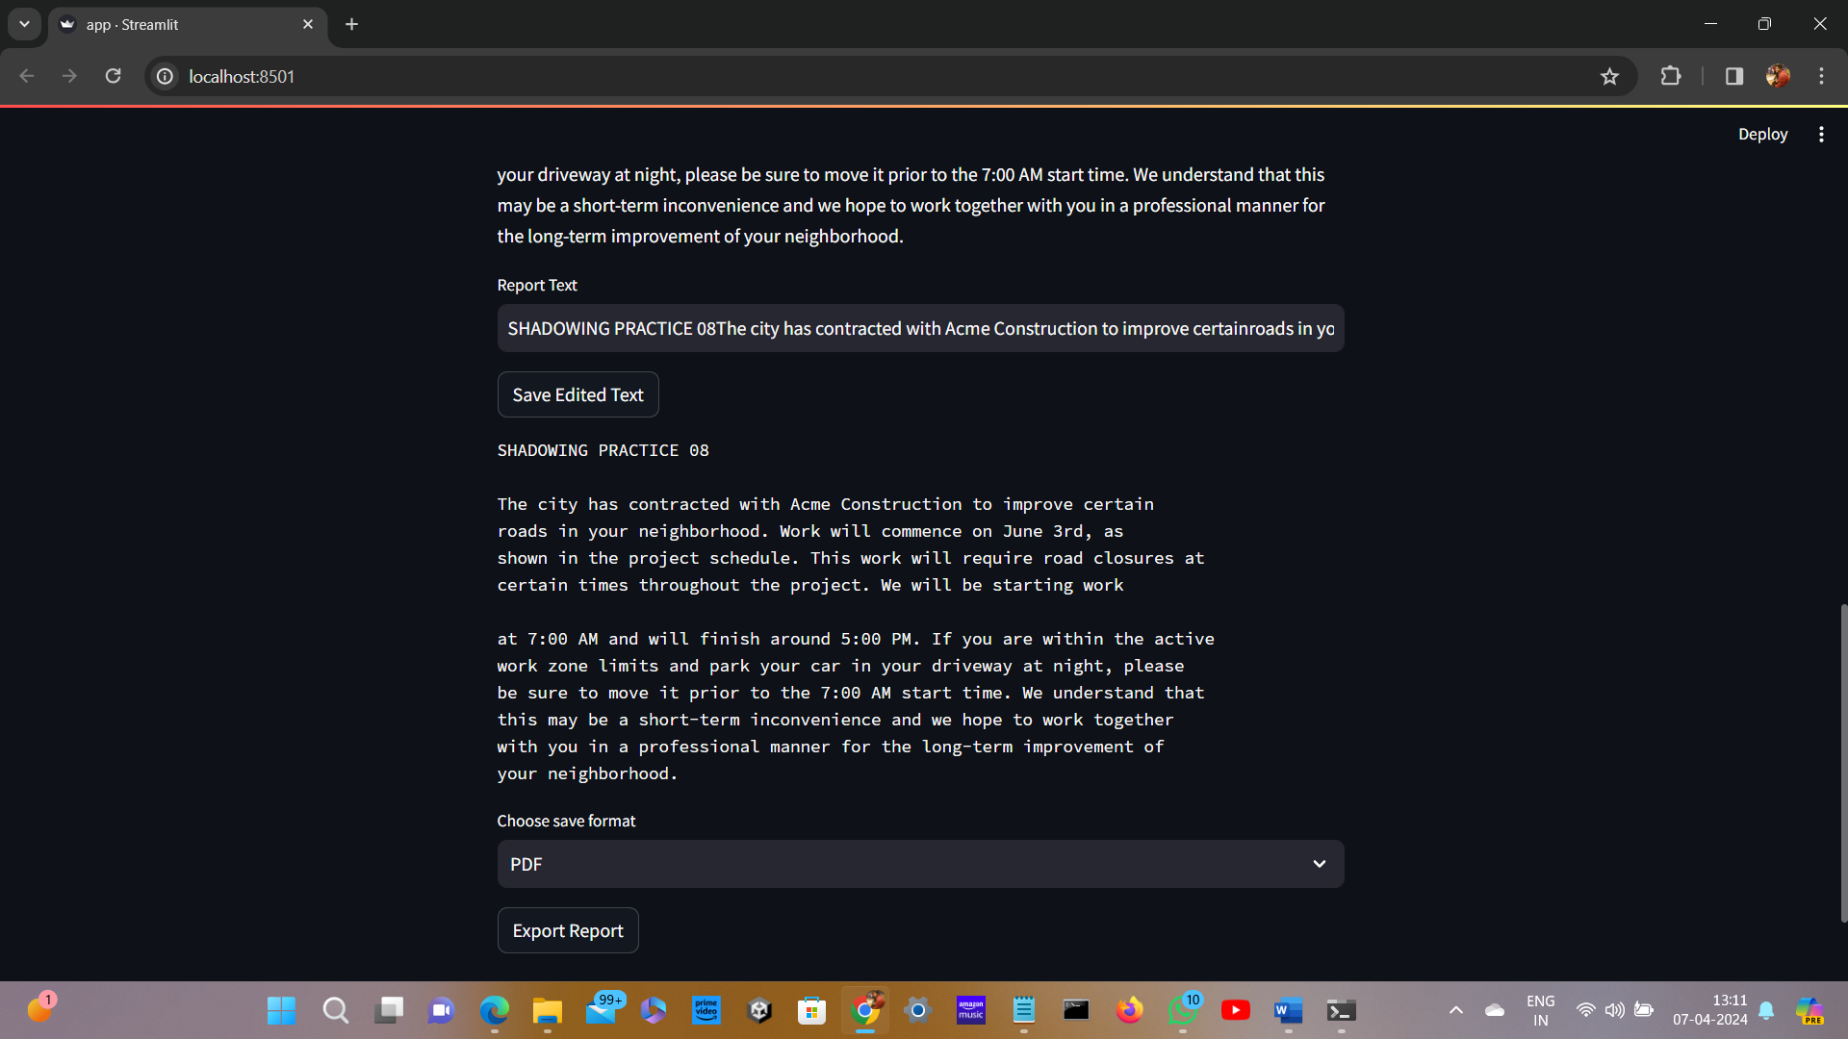

Slide 18
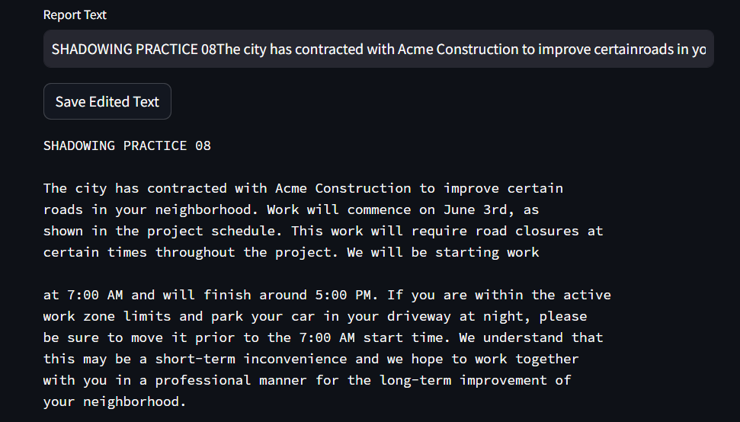

Slide 19
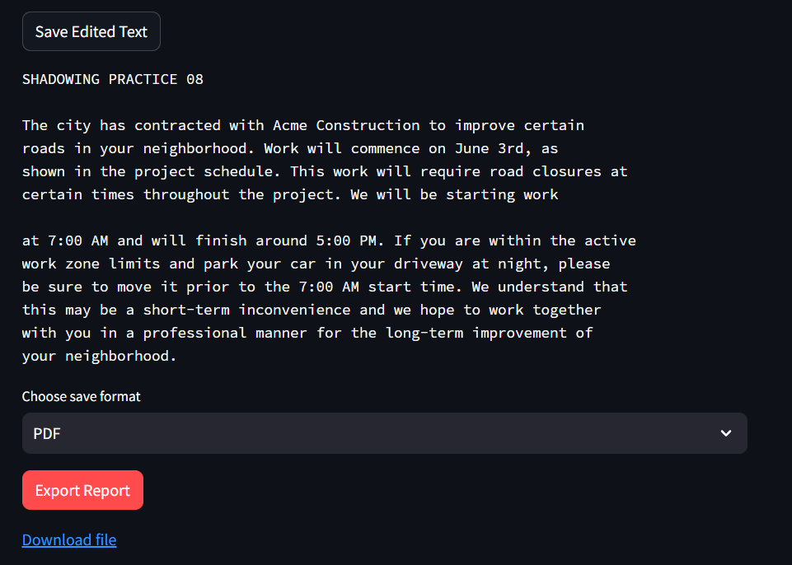

Slide 20
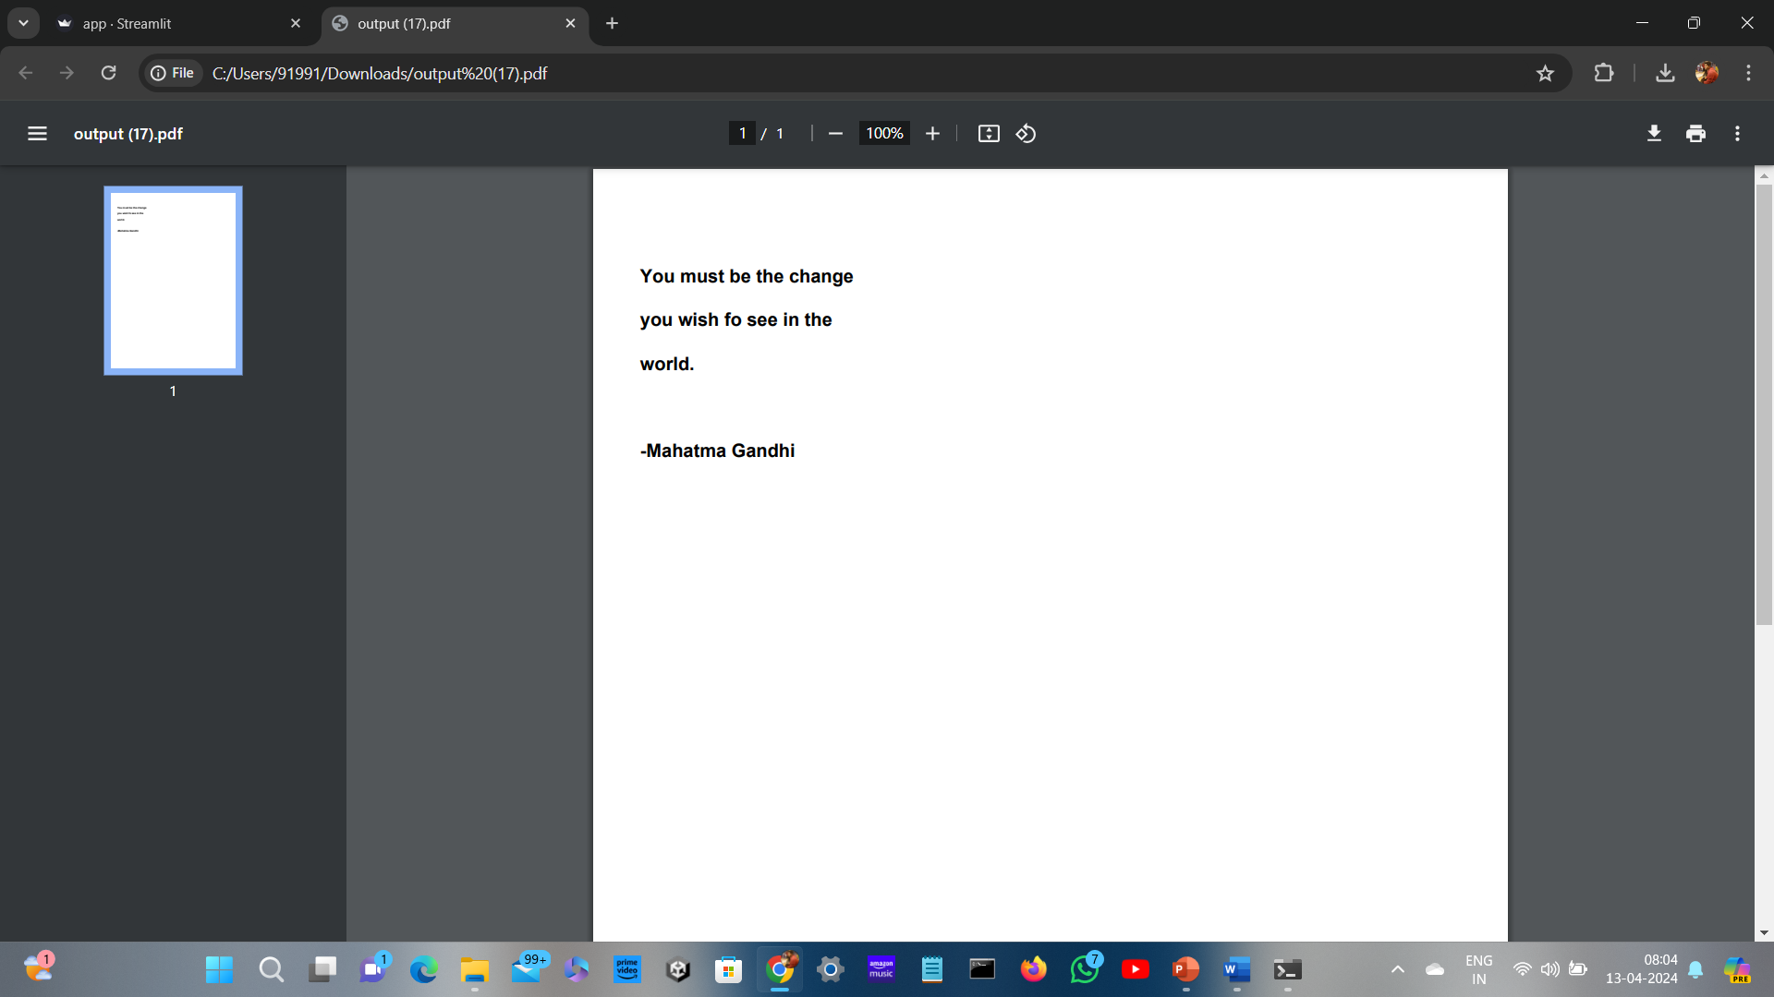

Slide 21
CONCLUSION
In conclusion, the Optical Character Recognizer (OCR) web application using Tesseract is a highly efficient and accurate tool for converting printed or handwritten text into digital format
The integration of Tesseract, a powerful open-source OCR engine, allows for excellent recognition capabilities across a wide range of languages and fonts
The web application provides a user-friendly interface that simplifies the OCR process, allowing users to upload images or scanned documents and receive the extracted text with ease
With its robust functionality and precise results, this OCR web application using Tesseract is a valuable tool for businesses, researchers, and individuals seeking to convert physical text into editable digital content

Slide 22
FUTURE ENHANCEMENTS
For future enhancements of the Optical Character Recognizer (OCR) Web Application, there are several possibilities
First, improving the accuracy of the OCR system by implementing advanced machine learning techniques and algorithms could be explored
This would involve training the system on a larger dataset and incorporating deep learning models
Another enhancement could be the addition of language support for more diverse character sets and scripts
Additionally, the application's user interface could be enhanced with features such as drag and drop functionality for easier importing of documents, the ability to save and export OCR results in multiple file formats, and integration with cloud storage services for seamless document management
An advanced search functionality could also be implemented to enable users to search for specific text within OCR results
Finally, integrating with other productivity tools and platforms, such as document editors or project management software, could further streamline the document processing workflow

Slide 23
REFERENCES
Wong, P. Y., & Alduais, N. A. M. (2022). Development of a Web-based Optical Character Recognition System. Applied Information Technology And Computer Science, 3(2), 370-387
Lestari, I. N. T., & Mulyana, D. I. (2022). Implementation of OCR (Optical Character Recognition) Using Tesseract in Detecting Character in Quotes Text Images. Journal of Applied Engineering and Technological Science (JAETS), 4(1), 58-63.
Bugayong, V. E., Villaverde, J. F., & Linsangan, N. B. (2022, March). Google Tesseract: optical character recognition (OCR) on HDD/SSD labels using machine vision. In 2022 14th International Conference on Computer and Automation Engineering (ICCAE) (pp. 56-60). IEEE..
Koo, X. T., & Khor, K. C. (2023, July). Expense Tracking with Tesseract Optical Character Recognition v5: A Mobile Application Development. In 2023 IEEE Symposium on Industrial Electronics & Applications (ISIEA) (pp. 1-5). IEEE.
Thammarak, K., Kongkla, P., Sirisathitkul, Y., & Intakosum, S. (2022). Comparative analysis of Tesseract and Google Cloud Vision for Thai vehicle registration certificate. International Journal of Electrical and Computer Engineering, 12(2), 1849- 1858.

Slide 24
THANK YOU
We thank our guide, panel, and all technical and non technical staff helped us in achieving this.

